Slide 1
RetailRocket ALS Recommender
Xiaolong, Fusheng, qing Gao, Wenxiong

Slide 2
1.
Business Goal and Value
recommend fashion products to customers

Slide 3
Business Goal
Improve the customer experience by solving the problem of choice overload
Encourage the customers to explore more products

Slide 4
2.
Methodology and techniques

Slide 5
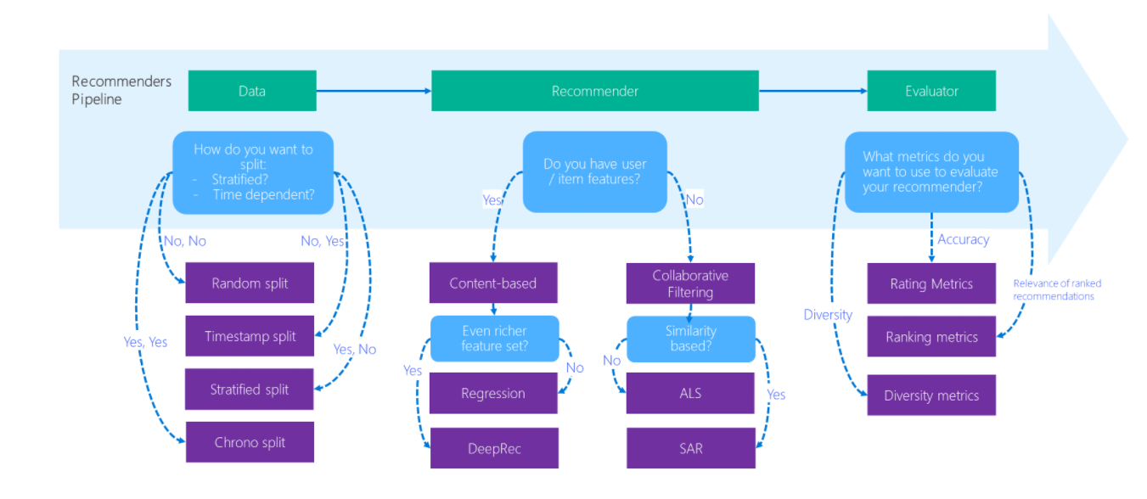
Overview

Slide 6
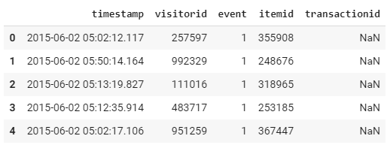
Data Preprocessing
Encode Event type to the following:
“View”:1, “Add to Cart”: 5, “Purchase”: 10
Transfer Timestamp to readable Datetime Value

Slide 7
Data Splitting
Random Split
Time Series Nested Cross Validation

Slide 8
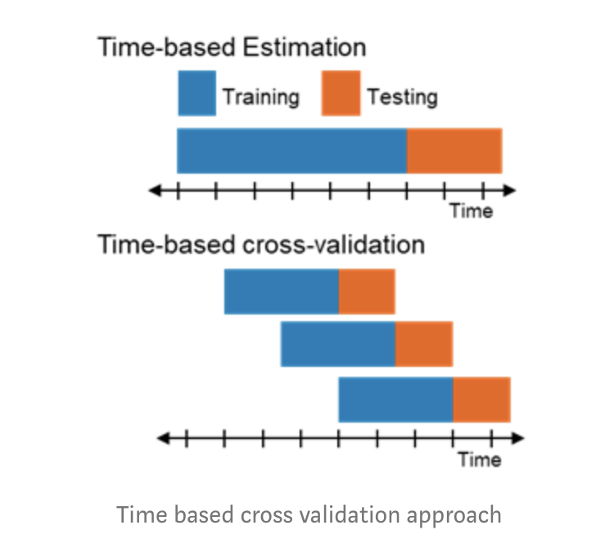
“Sliding window” training Approach

Slide 9
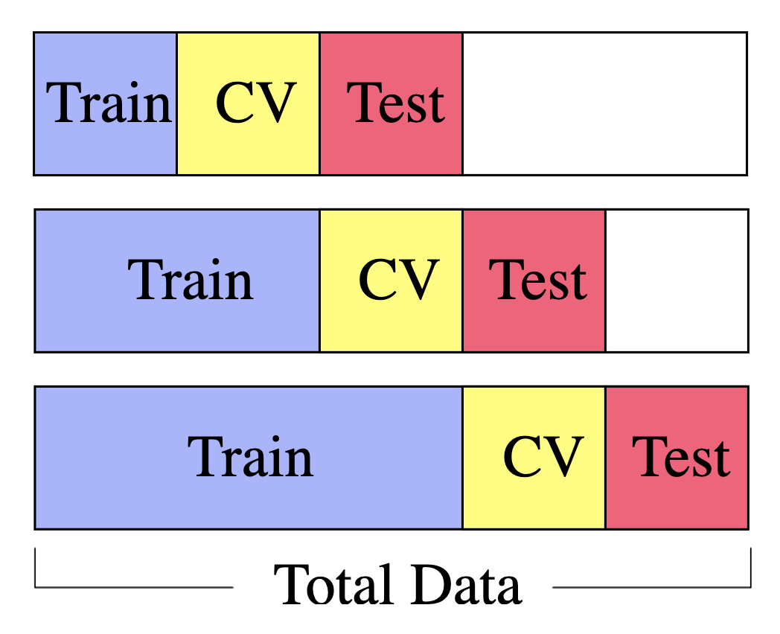
Time Series Nested Cross Validation

Slide 10
Modeling
Spark ALS
Implicit (Library)

Slide 11
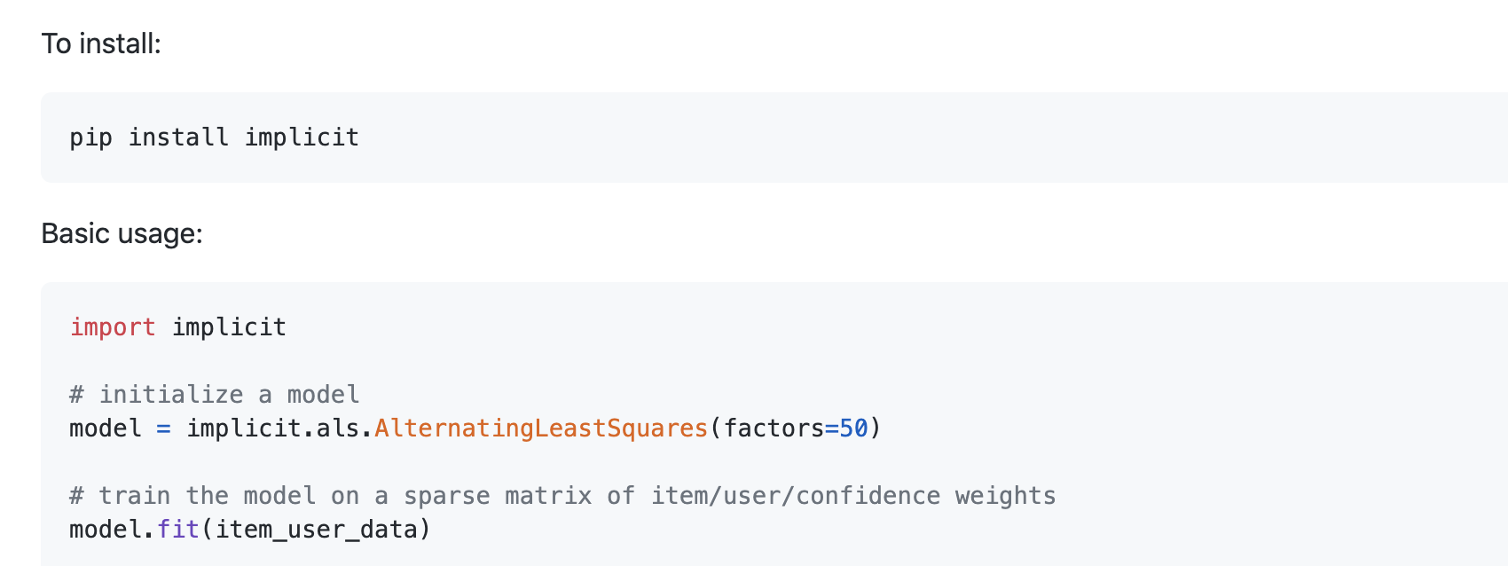
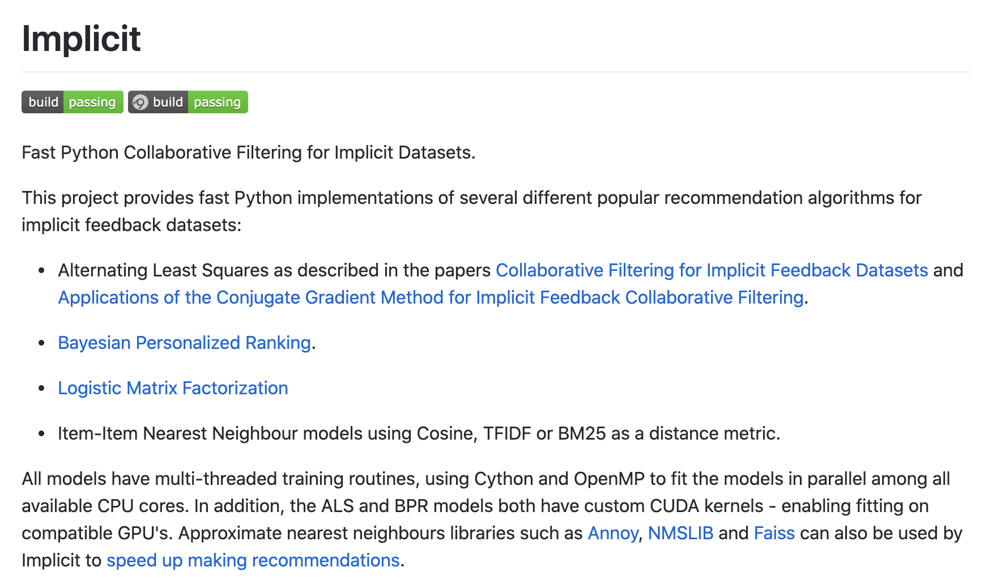
Library: Implicit

Slide 12
3.
Meaningful results and discussion

Slide 13
Recommendation Example
 | Random Split | Temporal Split
Train RMSE | 1.07 | 0.98
Test RMSE: | 2.006 | 1.9

Slide 14
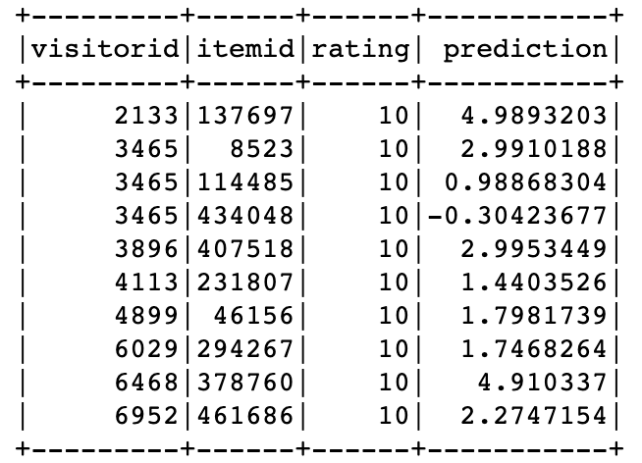
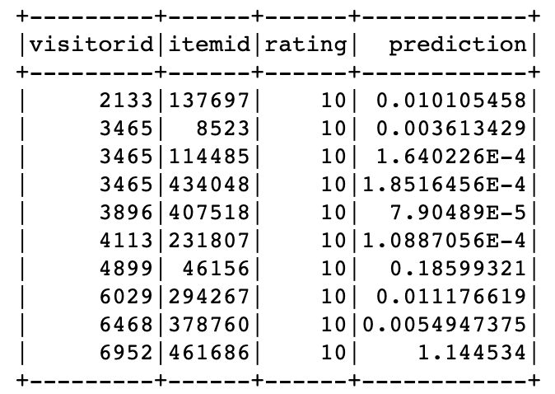
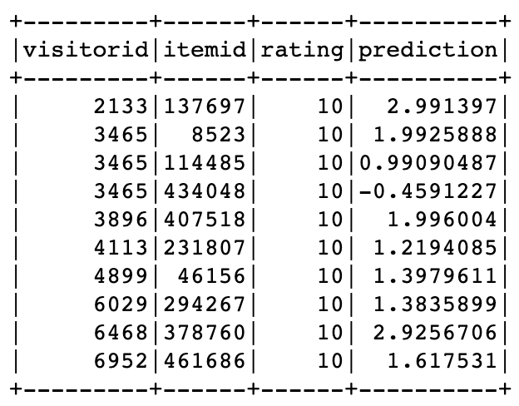
Model Comparison
“View”:1, “Add to Cart”: 5, “Purchase”: 10
rank = 10
Test Error = 1.62
“View”:1, “Add to Cart”: 5, “Purchase”: 10
rank = 10
implicitPrefs = True
Test Error = 1.45
“View”:1, “Add to Cart”: 3, “Purchase”: 10
rank = 10
Test Error = 1.45

Slide 15
4.
Rational Next Step

Slide 16
Precision at k evaluation
Handle long tail data
Model Tuning to increase predicting power

Slide 17
Q & A

